Slide 1

Urban Helper
JAVADOC JUVENILES
VINAY SRIVATSAN SRINIVASAN (001053018)
TANISHKA PORWAL (001398678)

Slide 2
Problem Statement
With the fast moving world, it is very difficult to take out time and visit furniture store to make our own furniture and then bring it back. Also, people face a lot of difficulty to give contracts to house builders and tell about their requirements every now and then. Same is the case with electric fittings.

Slide 3
Solution
To provide one platform where customers can place furniture request as well as house construction and electrical fitting request.
To provide employment to the skilled labours through our application.
To minimise the hustle of constructing our own furniture, and then bringing it back.
Specifying the requirements once, which will then be passed to each and every worker.

Slide 4
Approach
Construction Enterprise
House Builder organization
Electrician Organization
Furniture Enterprise
Demand and Supply Organization
Furniture Making Organization
Delivery Organization

Slide 5
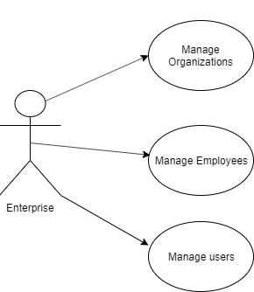
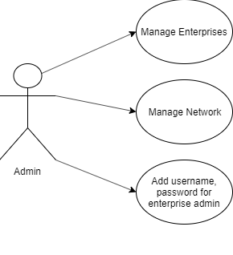
Use Case Diagram

Slide 6
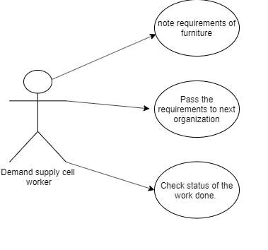
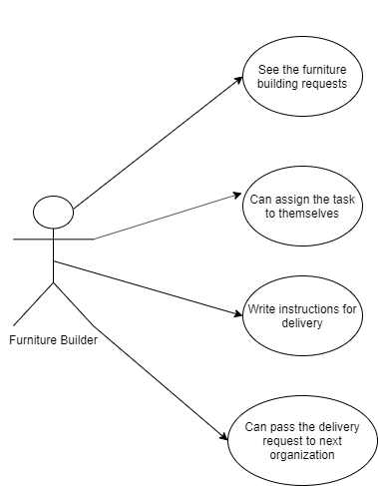
Furniture Making Enterprise

Slide 7
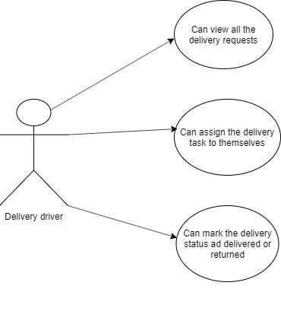

Slide 8
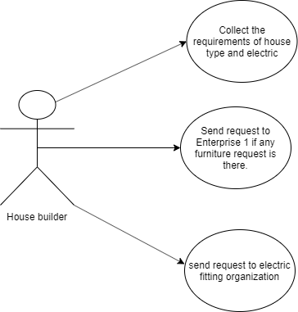
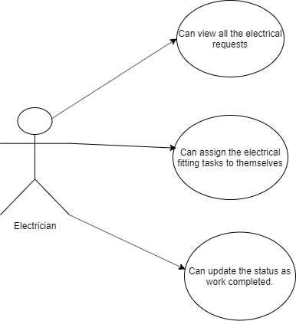
House Building and Electrician Enterprise

Slide 9
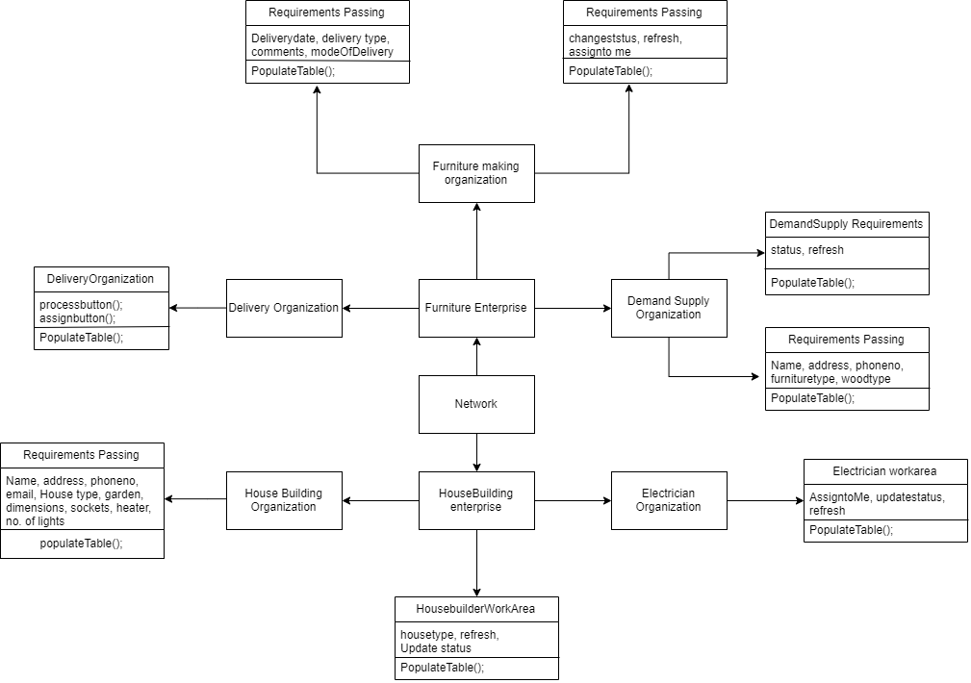

Slide 10
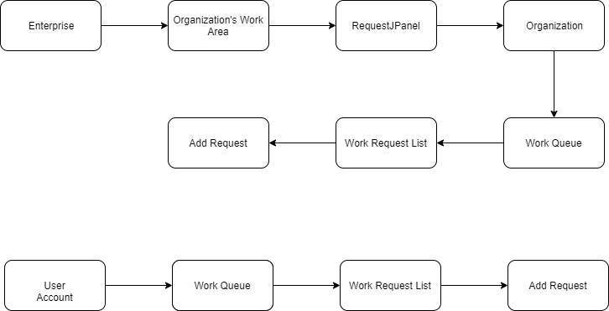
Work Flow

Slide 11
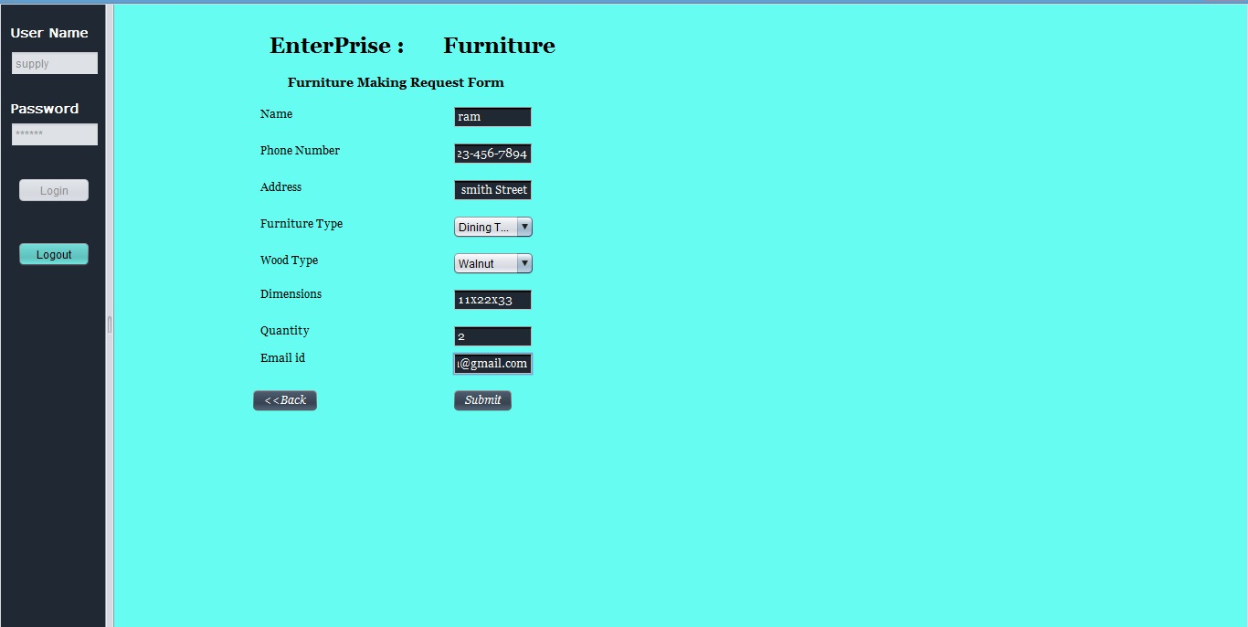

Slide 12
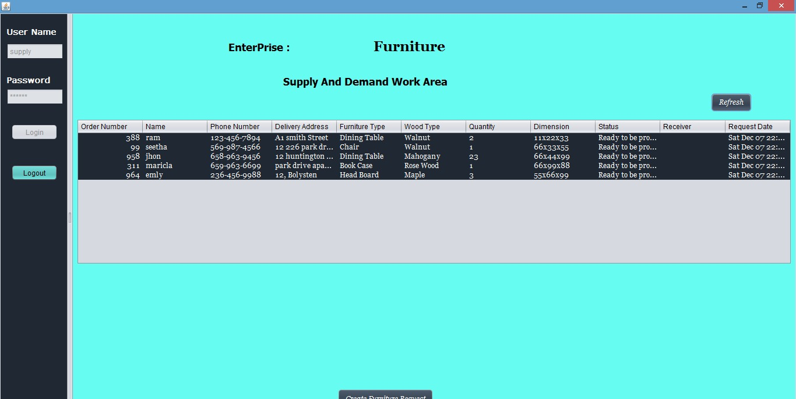

Slide 13
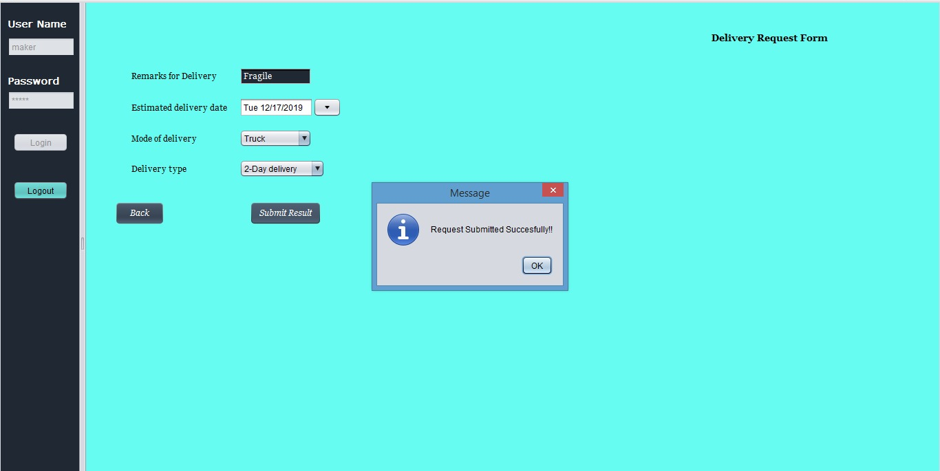

Slide 14
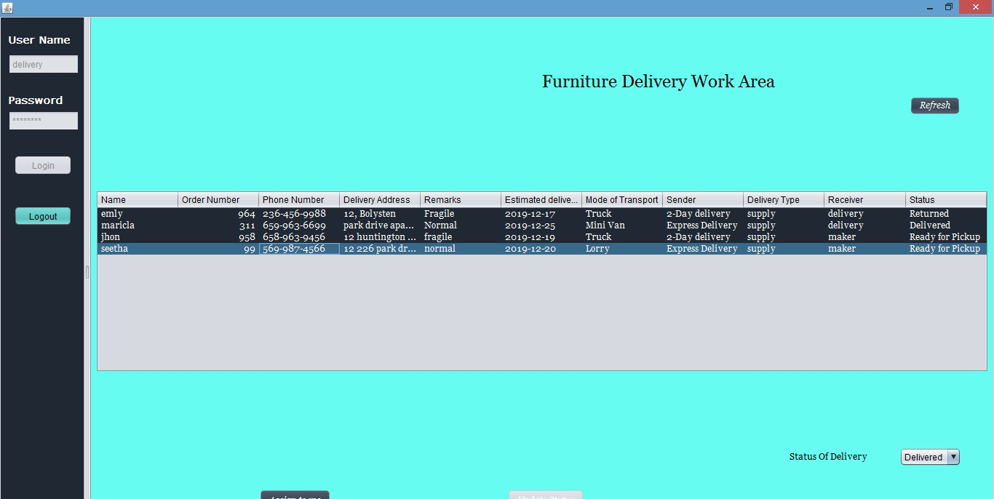

Slide 15
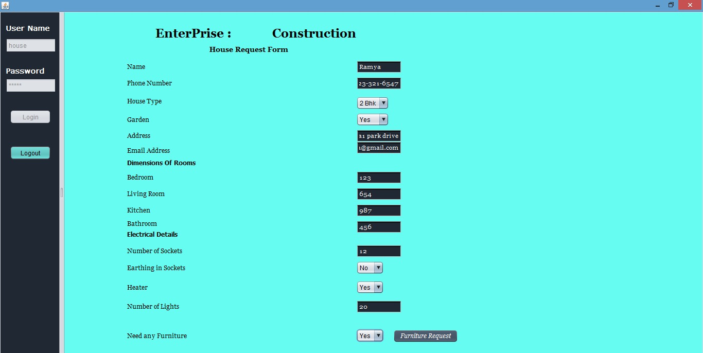

Slide 16
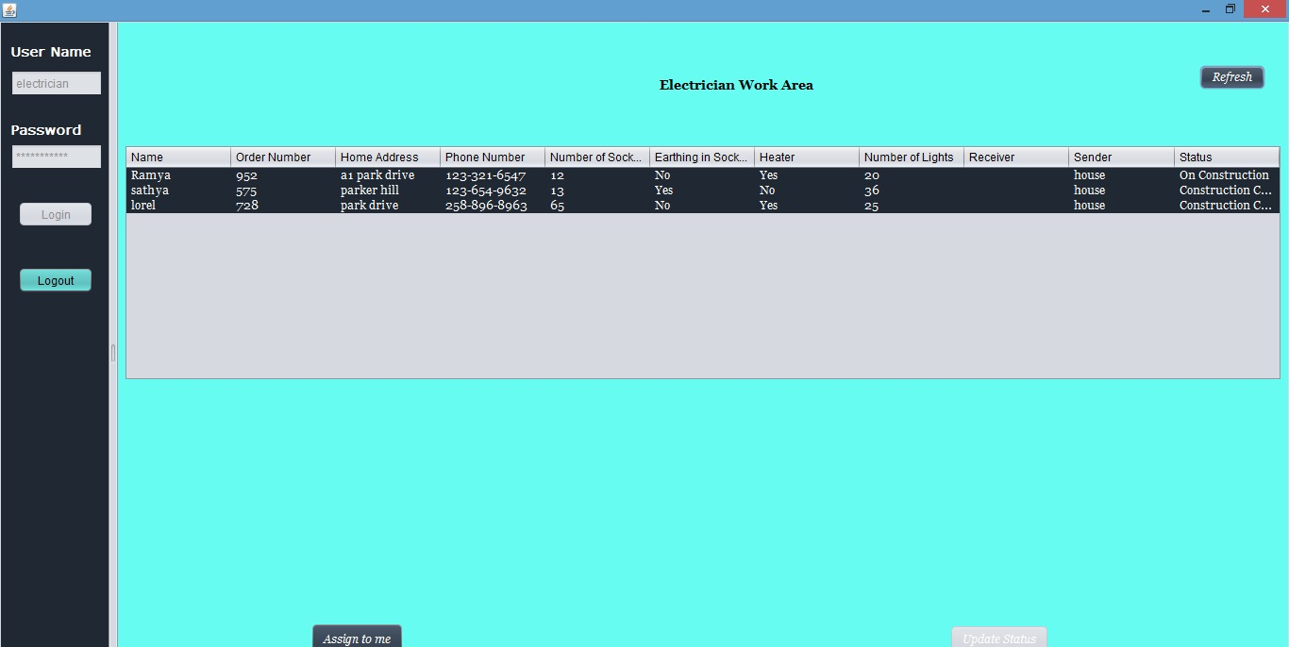

Slide 17
Demo!

